Slide 1
We’re Going to the Zoo, Zoo, Zoo: Supporting Teacher Candidates and Prek-12 Partners Through the Experiential Learning Zoo Project
Amy Wolfe, Debra Dunning, Teri Peasley, Kim Ciroli

Slide 2
Debra Dunning, Ph.D., Ohio University Lancaster
Amy Wolfe, Ph.D., Ohio University Chillicothe
Kim Ciroli, M.S., Ohio University Eastern
Teri Peasley, EdD., Ohio University Zanesville Acknowledgement of our colleagues who are not presenting with us today: Jennifer Lisy, Ph.D., Ohio University Zanesville
Martha Evans, Ph.D., Ohio University Southern
Kevin Deitle, Ph.D., Ohio University Southern
RHE Faculty in OneOHIO model
Includes 5 campuses in SE OHIO
Experiential Learning Grant funding (internal)
Clinical model
Professional Development Schools

Slide 3
The problem
The problem:
Prek-5 schools emphasize reading and math, areas subject to testing, while science and social studies are often neglected.
While all our OHIO education majors must earn a C in their science and social studies content courses, many need to repeat these courses and, still, often pass with minimal mastery.
In OneOHIO we need to build an sustain relationships among students across the RHE system so ensure their participation and engagement in our remote synchronous shared courses.

Slide 4
Experiential Learning
Engagement: In Phase 1, cross-campus teams candidates will explore the zoo to gather information on science and social studies content, including pre-and-post activities for prek-12 students. They will learn about Columbus Zoo’s educational resources and make a field trip plan for prek-5 to be presented to the whole cohort. In Phase 2, these teams will collaborate over Teams to plan the campus-based zoo visit. They will meet over Teams again for a reflection on their campus zoo program.
Mentorship: Candidates will be mentored by their faculty and clinical partners through the process of planning a field trip and implementing an educational program. They will be connected to educational professionals at the Columbus Zoo to support their professional growth and expand their career options. They will be supported in written self-reflection and verbal reflection in facilitated Teams meetings.
Challenge: This project challenges candidates to plan and implement an educational program which will support their professional development while engaging collaboratively with prek-12 partners and gaining practical teaching experience.
Ownership: Candidates will be charged with creating their own field trip plans and developing and implementing their campus educational program visit, including team-developed activities, with the support of their faculty and clinical educators.
Self and social awareness: Candidates engage in facilitated reflection during the experiential learning project, which will continue into the senior year when they read The Knowledge Gap (Wexler, 2019) in ECEE 4500.

Slide 5
Our solution
Goal
to further develop candidates’ science and social studies content knowledge and increase candidate confidence and enthusiasm for these content areas which will translate into their long-term teaching practice thus benefiting countless prek-12 students over time.
A two phase yearlong plan
In phase 1 (Fall 23), juniors will go to the Columbus Zoo to learn how social studies and science standards can be met on a field trip to the zoo.
During phase 2 (Spring 24), in conjunction with science and social studies methods courses, the candidates will plan and host a campus-based zoo program for prek-5 students at partner schools, including activities planned and facilitated by candidates.

Slide 6
Pre-trip questionnaire
How frequently they have been to the zoo
Open-ended reflection on:
Anticipated benefits to their participation in the trip
Barriers to implementation
Possibilities for their future classroom
Their identification with statements:
I believe students learn best from real world experiences
I believe that differences in experiences outside of school put some students at an advantage over other students.
I believe that extracurricular experiences are directly related to academic achievement.

Slide 7
Pre-trip questionnaire

Slide 8
Pre-trip questionnaire

Slide 9
Pre-trip questionnaire

Slide 10
Pre-trip questionnaire

Slide 11
Pre-trip questionnaire

Slide 12
Pre-trip questionnaire

Slide 13
Pre-trip questionnaire

Slide 14
Pre-trip questionnaire

Slide 15
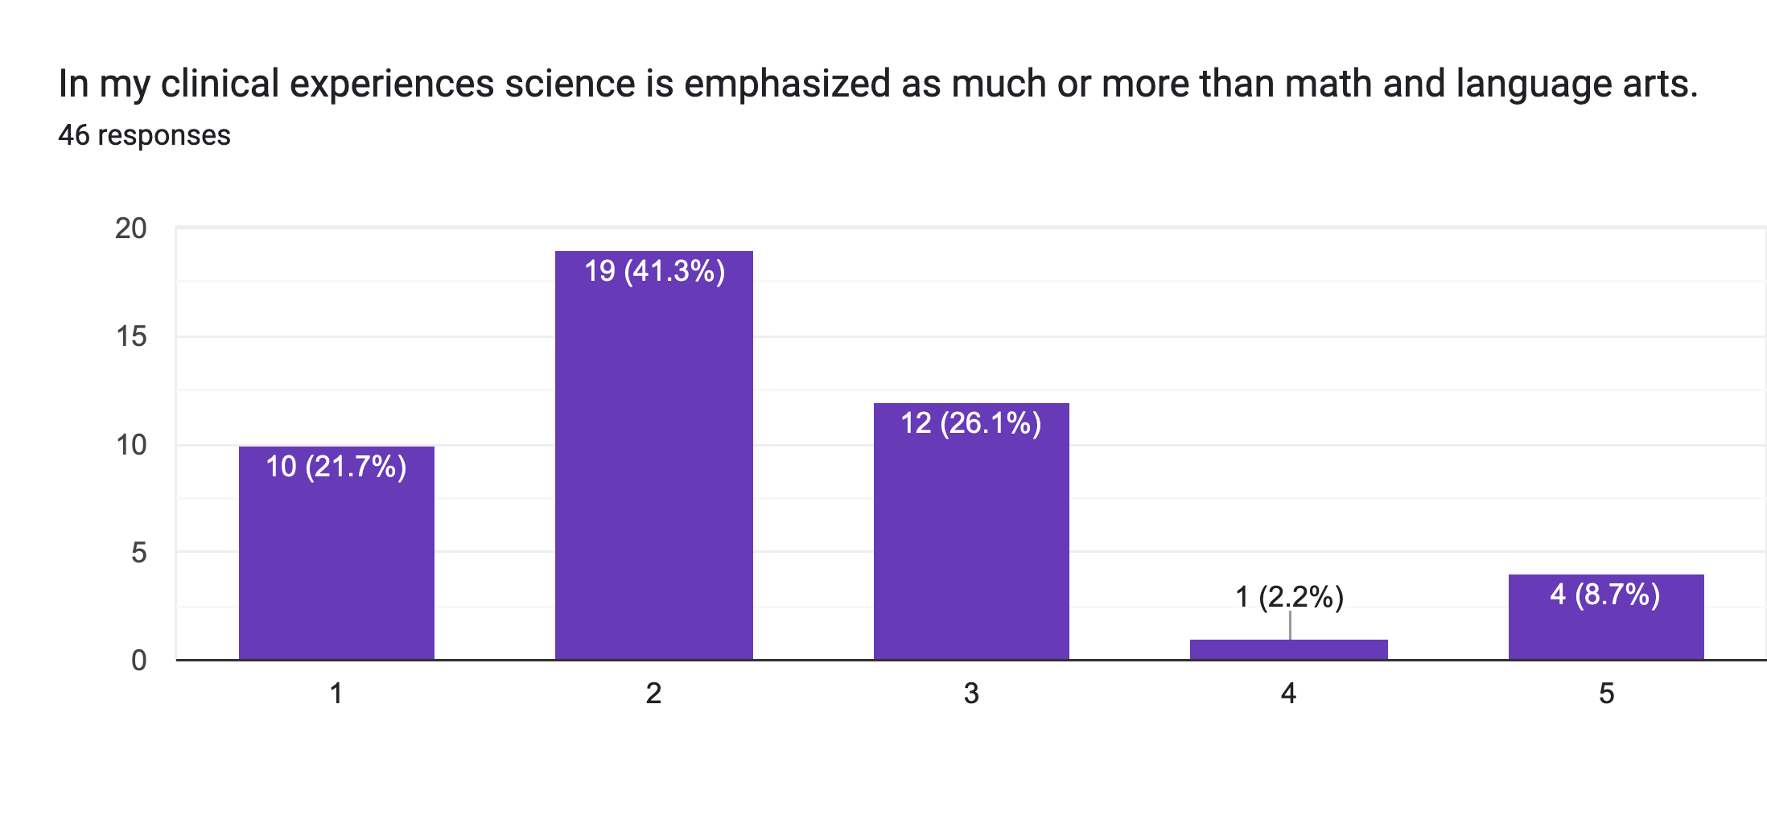
Pre-trip questionnaire

Slide 16
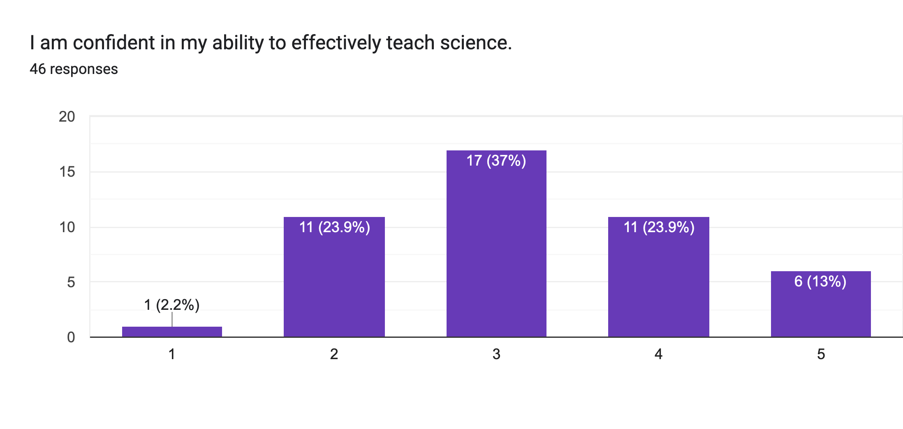
Pre-trip questionnaire

Slide 17
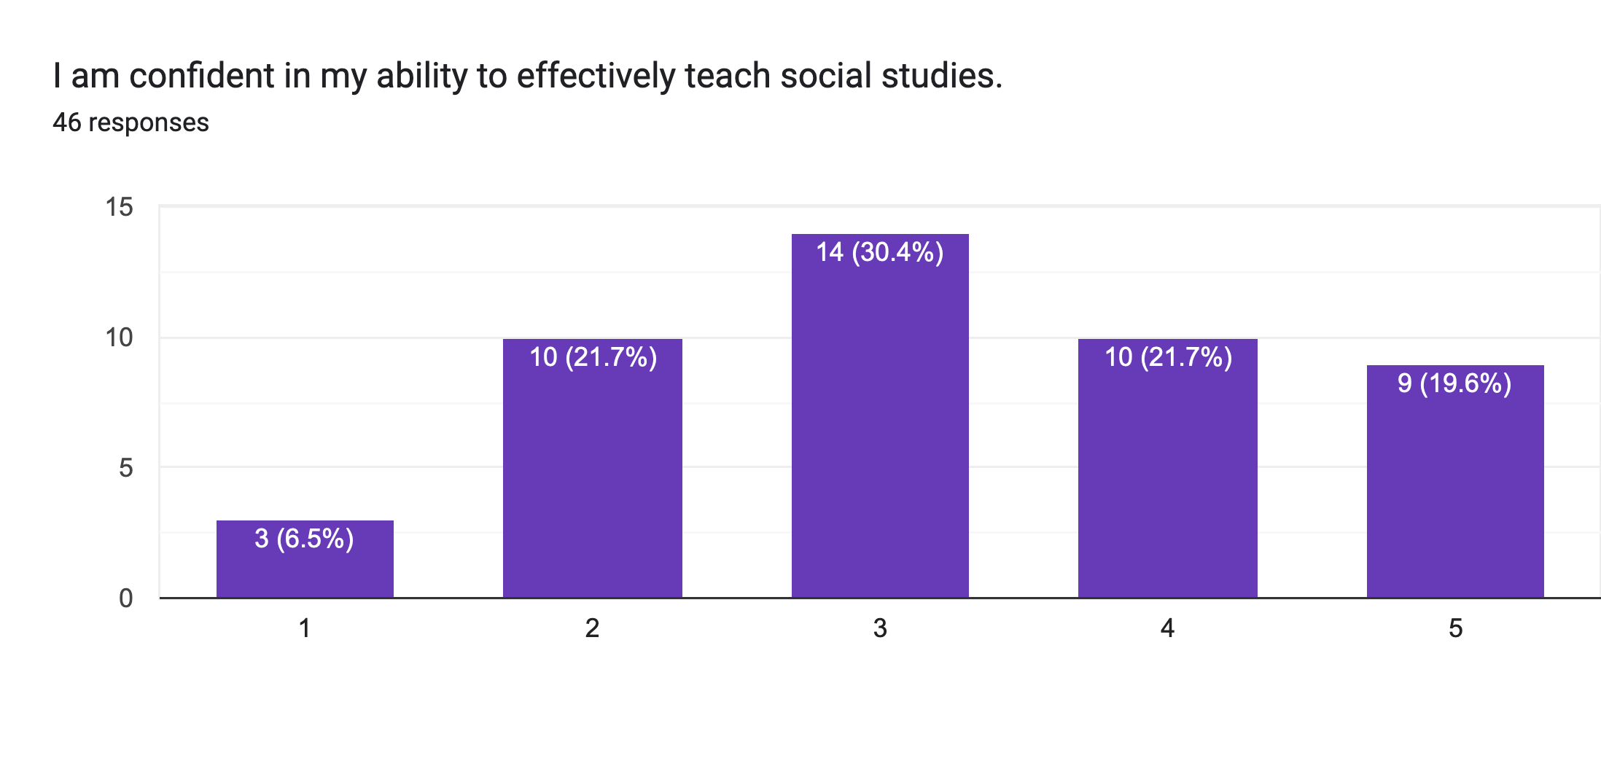
Pre-trip questionnaire

Slide 18
Pre-trip questionnaire qualitative
Candidates anticipate funding as the biggest challenge to taking students to the zoo with ensuring student safety as a close second
They anticipated that students would benefit from both academic and social learning from a trip to the zoo.
"I would love to take my students to the zoo. I believe every child should experience going to the zoo. You can’t teach kids about the zoo without them going there and having the real life experience. I was lucky growing up because I grew up with animals at my house and my cousins and grandparents. Many kids don’t have even those experiences, so taking my students to the zoo is a great way to give them that amazing experience!"

Slide 19
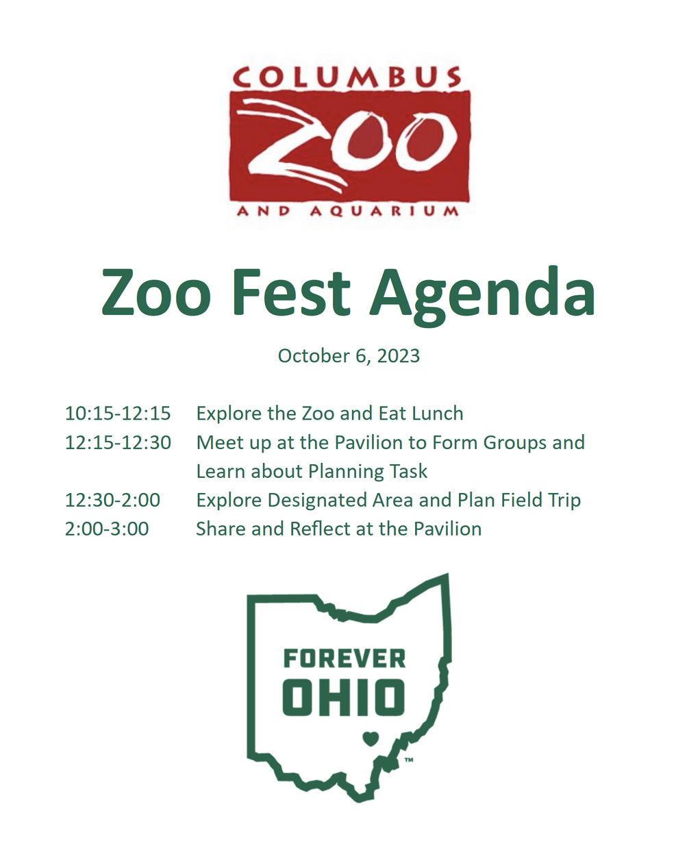
Our visit
October 6th
T-shirts
Transportation/ parking/ admission
Lunch
Their mission

Slide 20
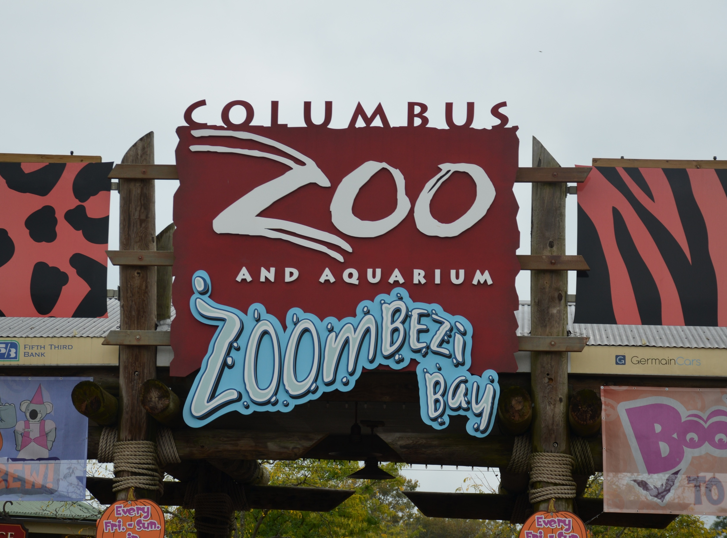
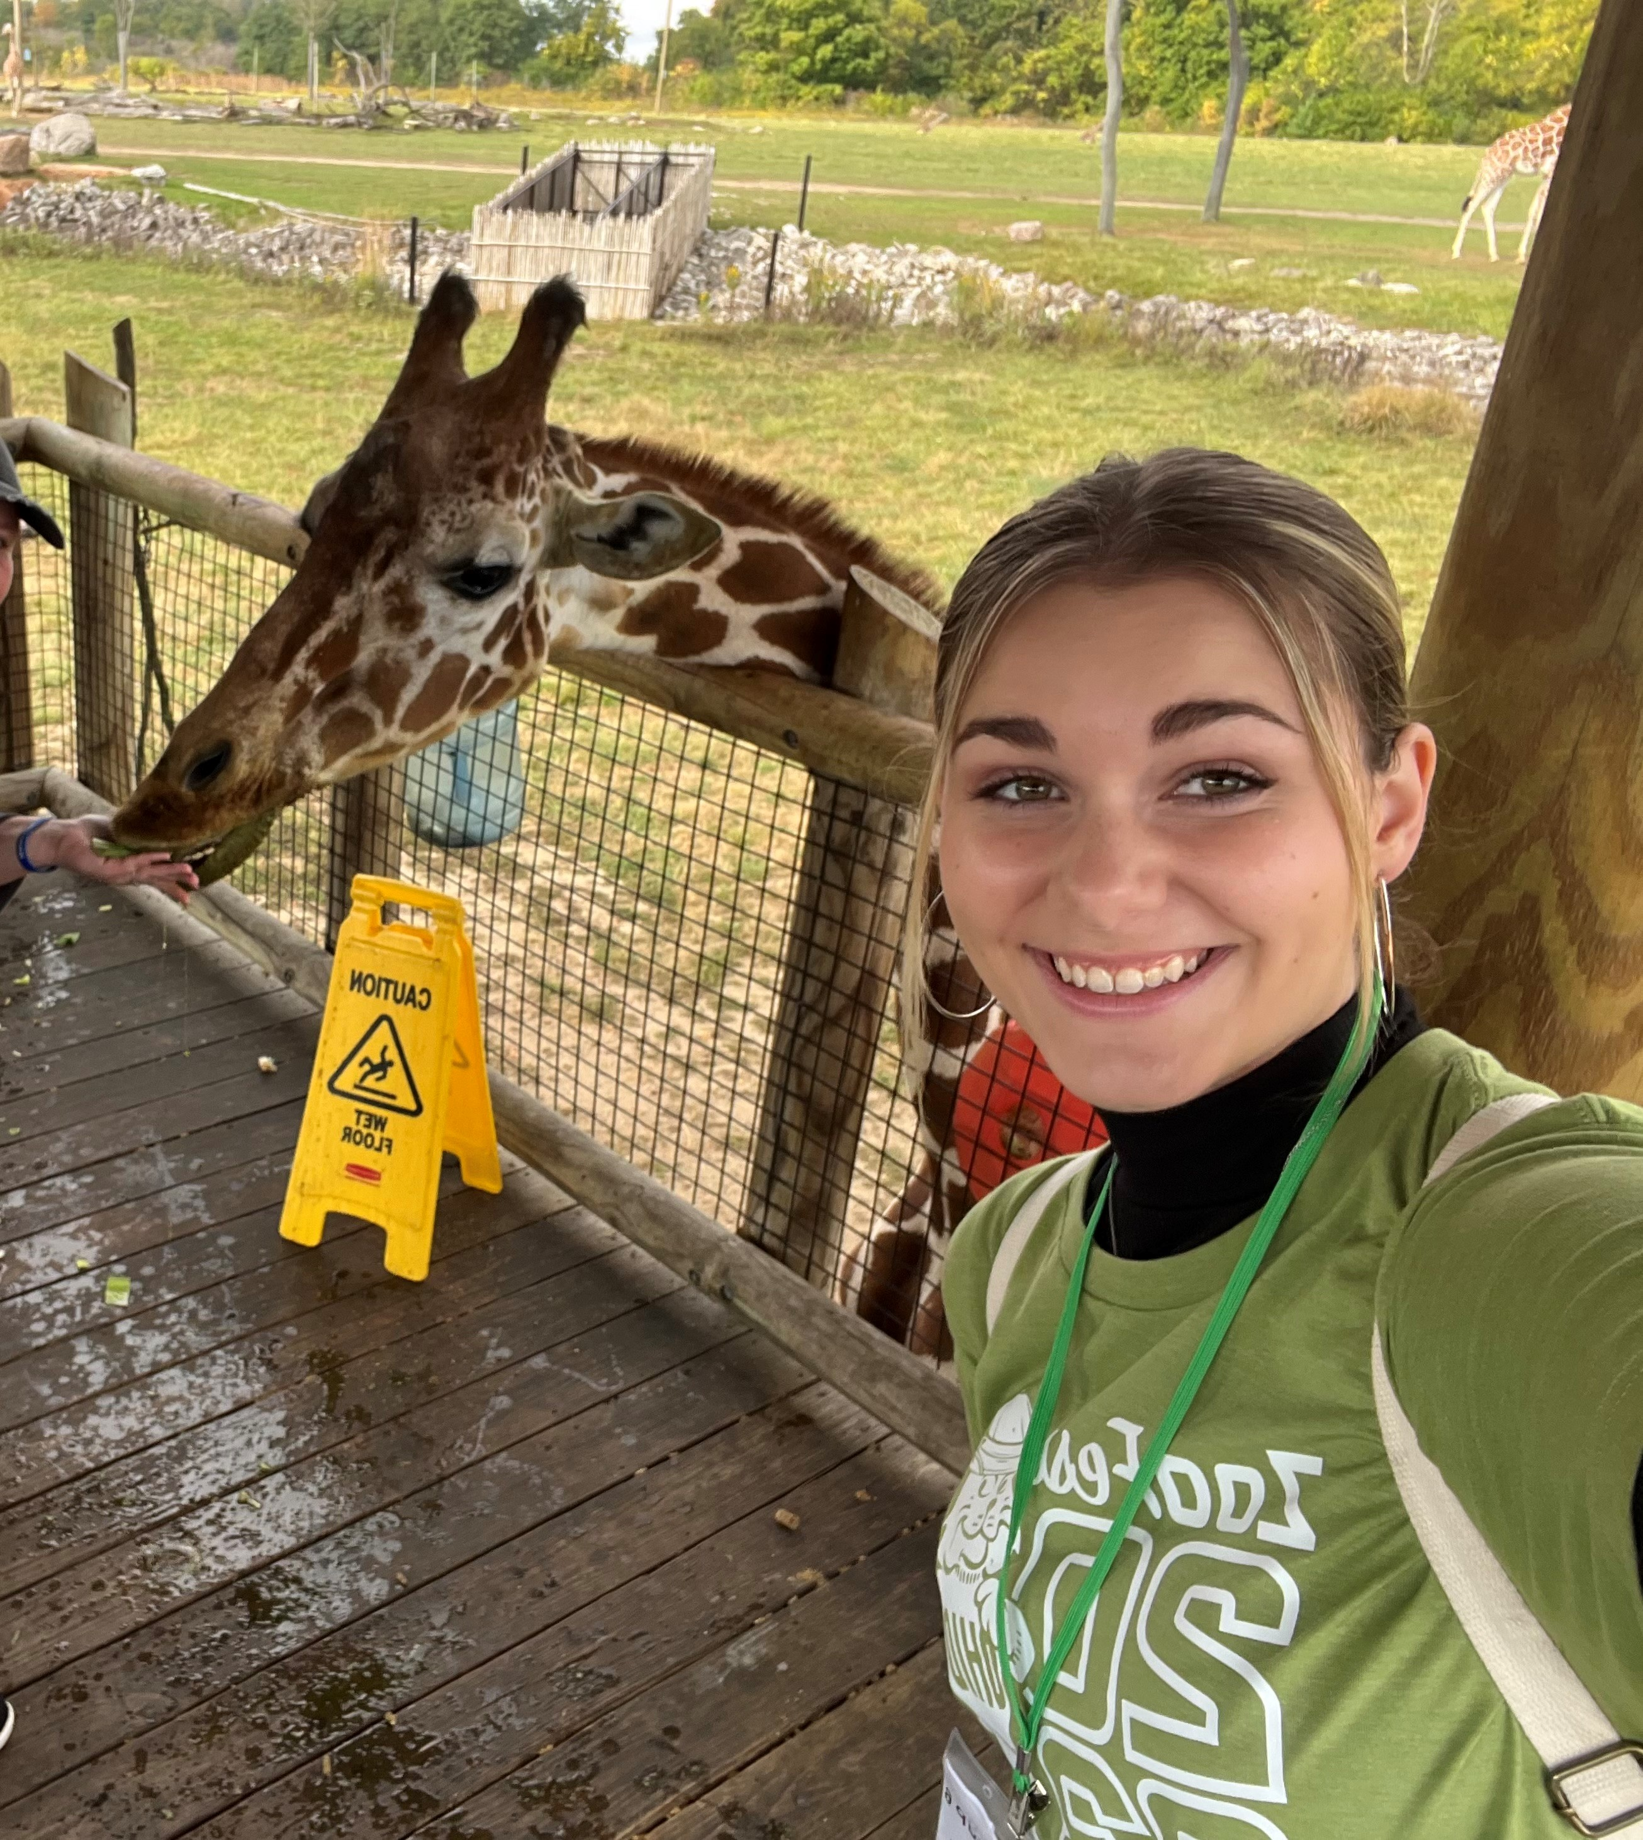
Our visit

Slide 21
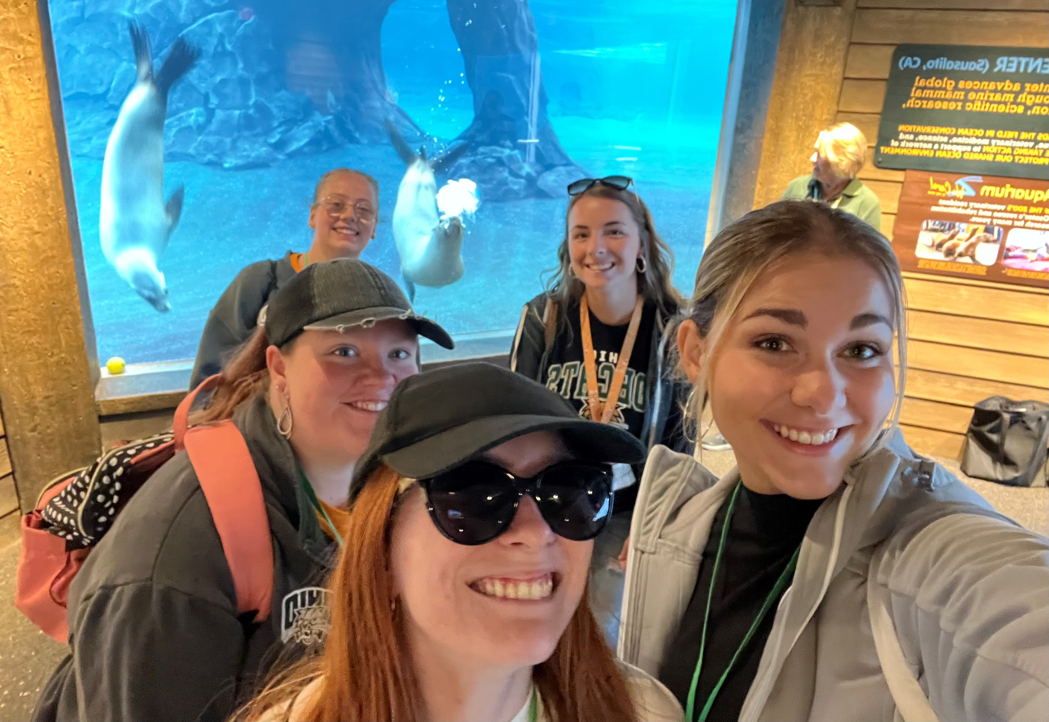
Our visit

Slide 22
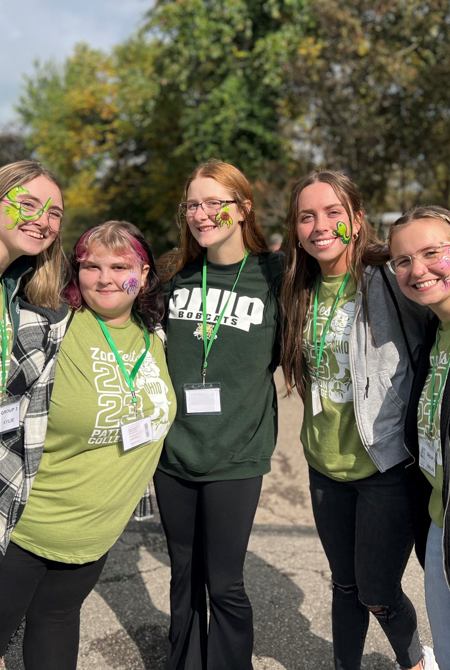
Our visit

Slide 23
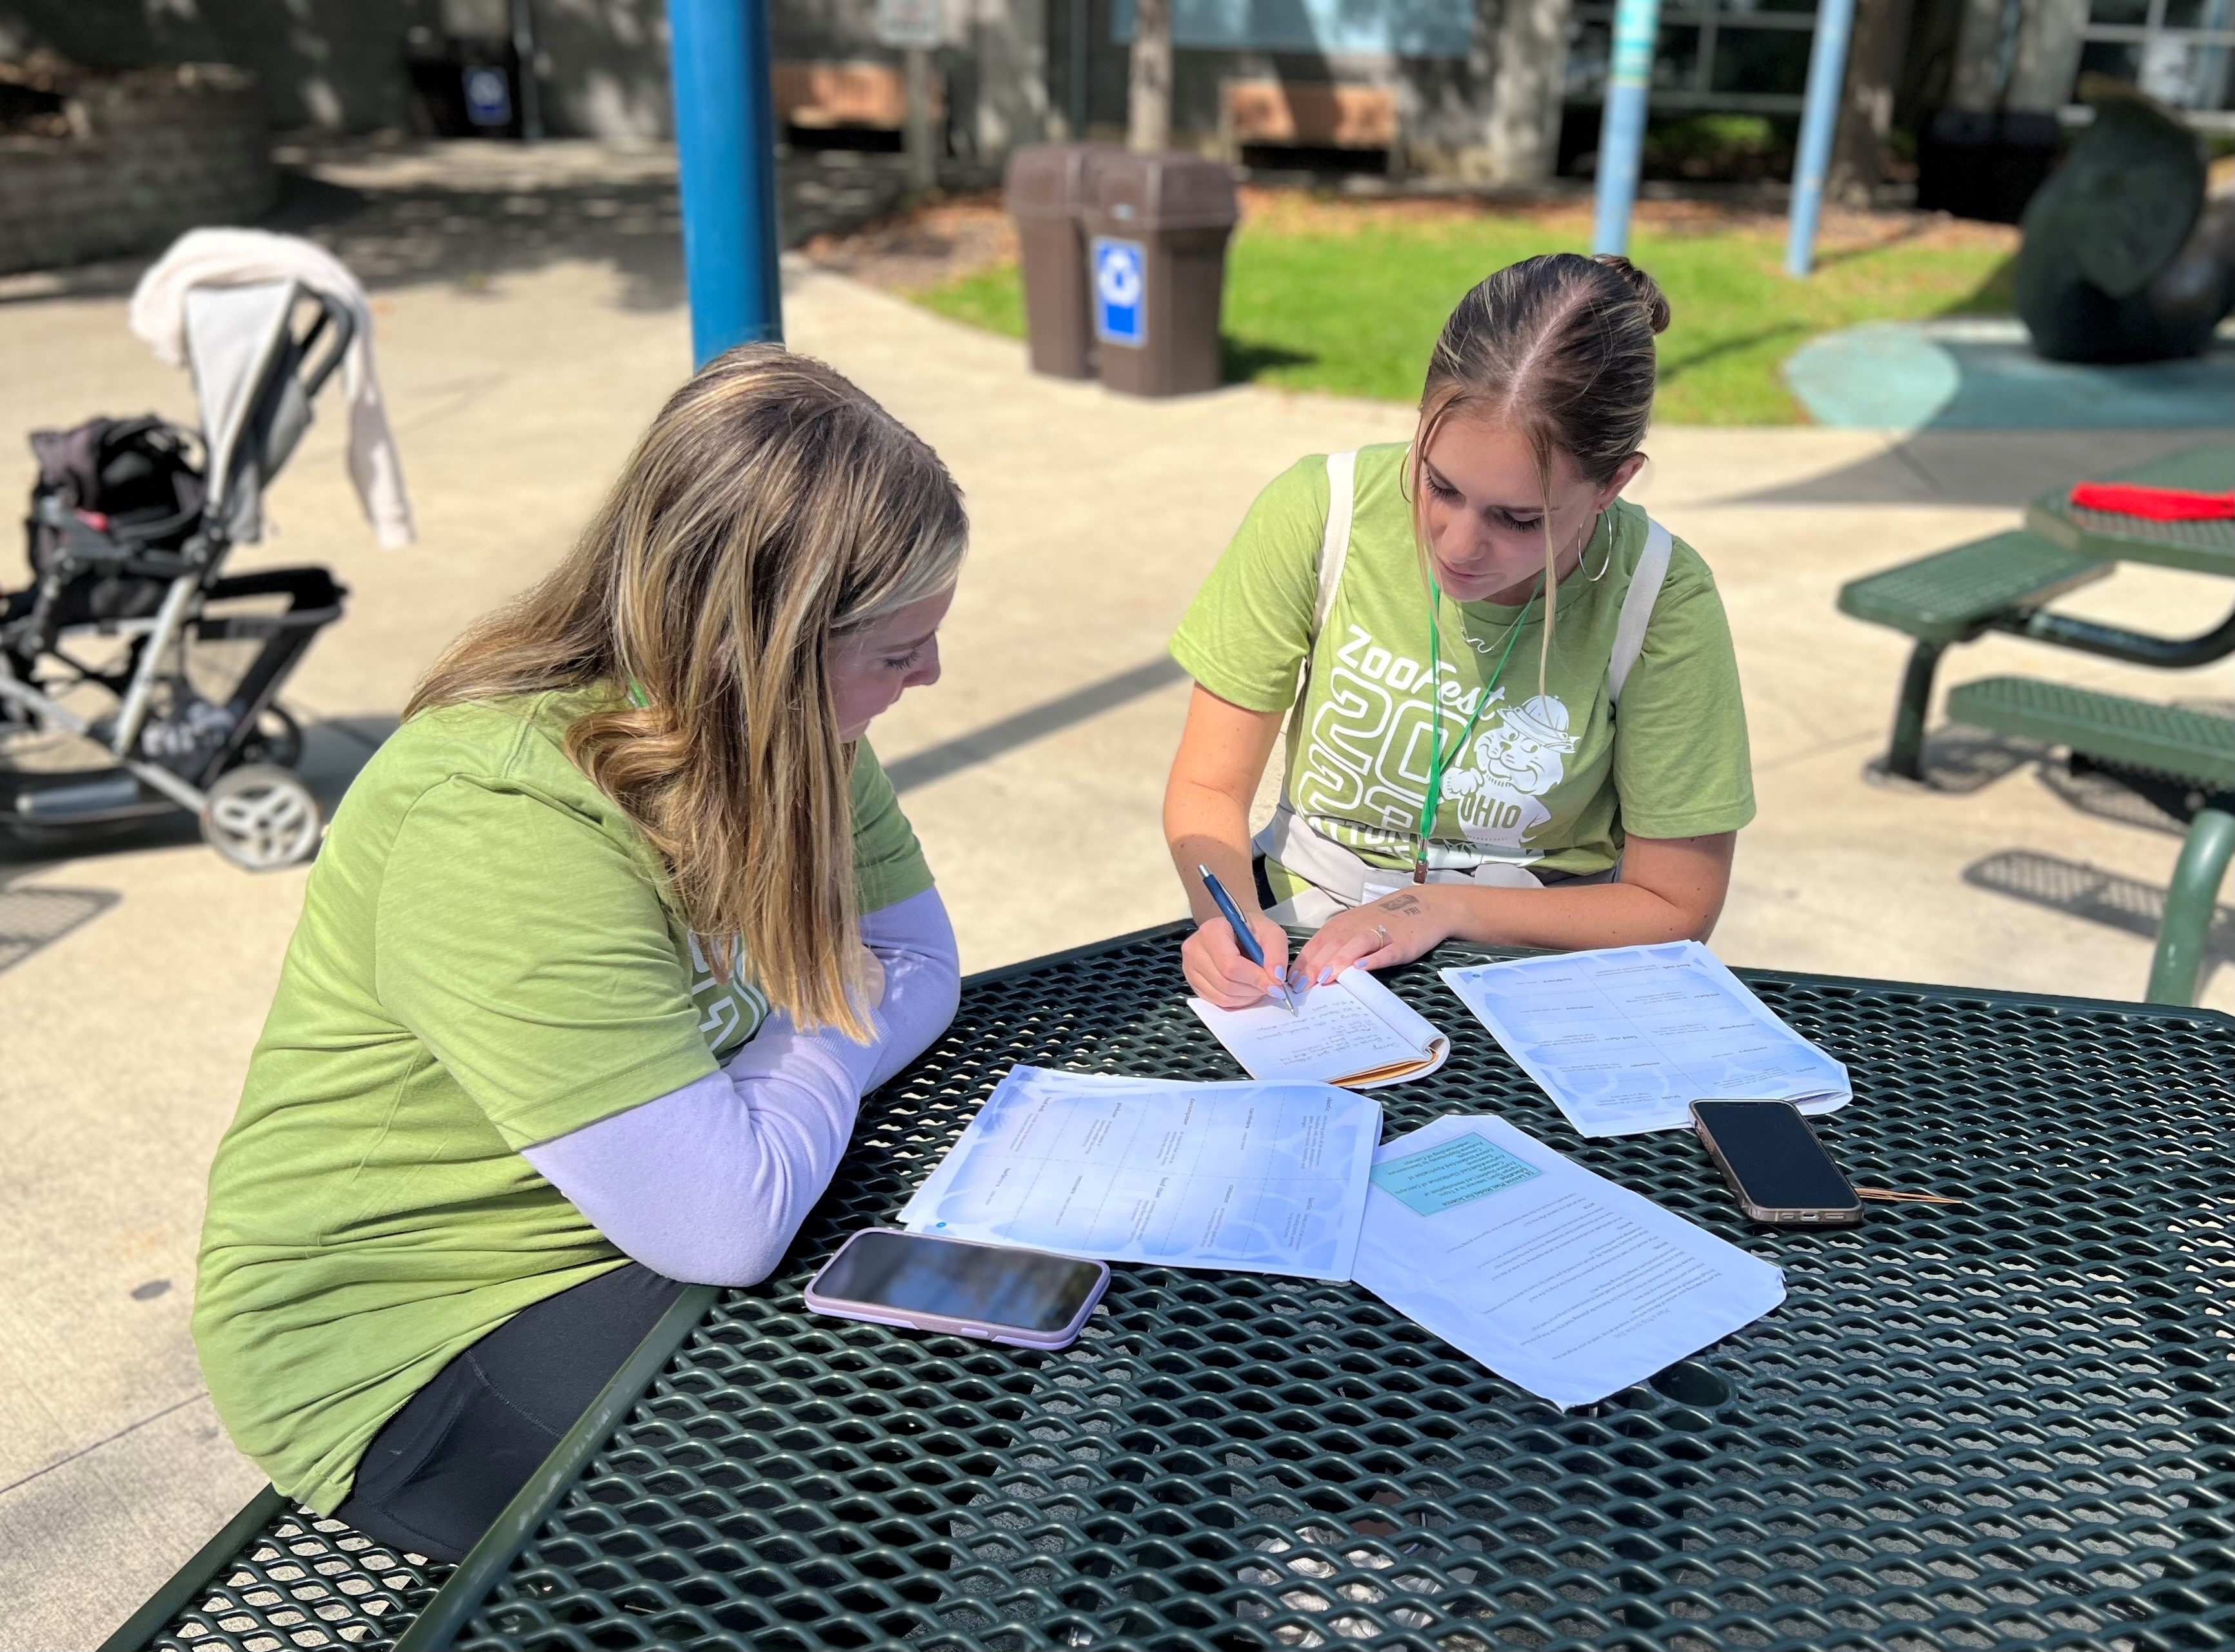
Our visit

Slide 24
Post-trip questionnaire

Slide 25
Post-trip questionnaire results
POSITIVES | AREAS TO IMPROVE
Enjoyed time with peers | Some wanted more structure such as a tour of the zoo
Enjoyed free time/ exploration | Other location or virtual option
Appreciated the zoo speaker | Would have appreciated lunch being provided
Beautiful weather, enjoyable experience | Include public school partners
Appreciated using teacher lens in familiar place
"I enjoyed exploring a specific area in depth for our activity. I learned a lot about Asia and the animals within it. I also learned how to tie field trips into the classroom and make them a fun, learning experience. I think taking children to the zoo is a great way to wrap up or start a topic on animals, habitats, the food chain, etc. This trip has inspired me to think outside of the box and come up with more hands on, interactive activities and trips for my students to help them apply their knowledge to the real world and make that connection."

Slide 26
Next steps
In Spring 2024, each campus will plan and host a Zoo educational event for prek-5 students on campus
Teacher candidates will plan and implement educational activities related to the zoo program in connection with their science and social studies methods courses
In Fall 2025, teacher candidates will read and discuss the Knowledge Gap, making connections to their zoo experiential learning
We are discussing possibilities for future collaborations and shared experiences to support and sustain relationships among candidates across our RHE system.

Slide 27
Discussion
How might you apply this model to your setting?
What are some other places candidates may benefit from visiting?

Slide 28
Contact
Amy Wolfe amy.wolfe@ohio.edu
Kim Ciroli ciroli@ohio.edu
Teri Peasley peasley@ ohio.edu
Debra Dunning dunning@ohio.edu

